Slide 1
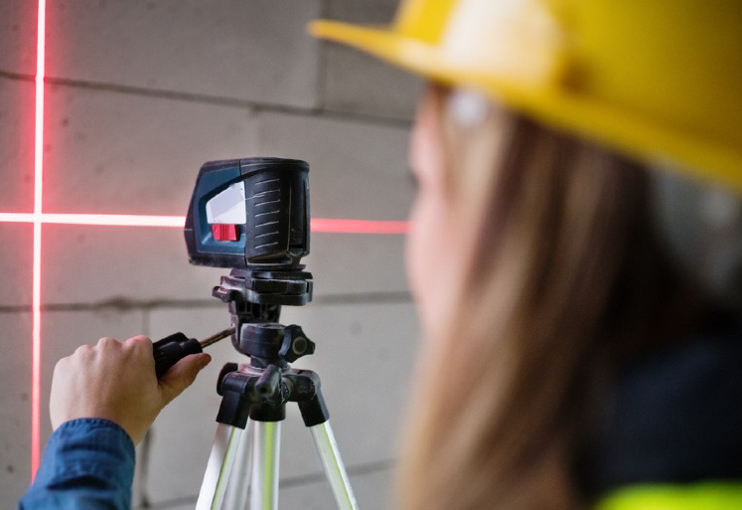
meshARment
Virtual Reality Toolkit

Slide 2
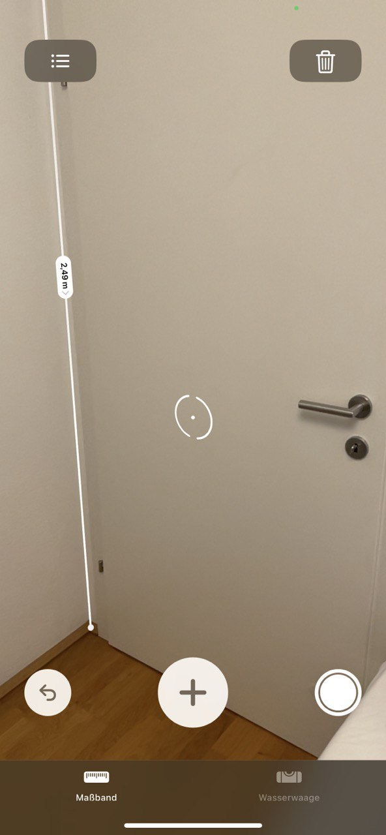
1. Introduction: Inspiration
Programm a digital toolkit for iOS devices with LIDAR
Using depth information to get a quick and rough estimate of environment
Enable quick measurements of inclination of surfaces
Optional: measurement of distances, areas and volumes
To be used on construction sites and in domestic use
Notes:
Briefly introduce your app and its purpose.
Explain the problem your app is solving and why it is important.

Slide 3
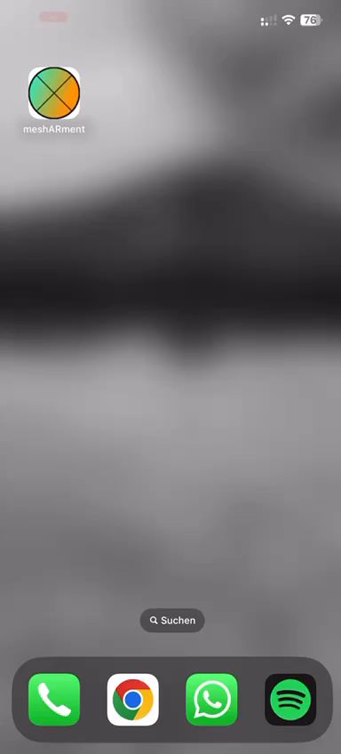
1. Introduction: meshARment
Goals reached:
Meshing working, rendered with a shaded overlay
Placing endmarkers
Displaying measurement in meters and degree

Slide 4
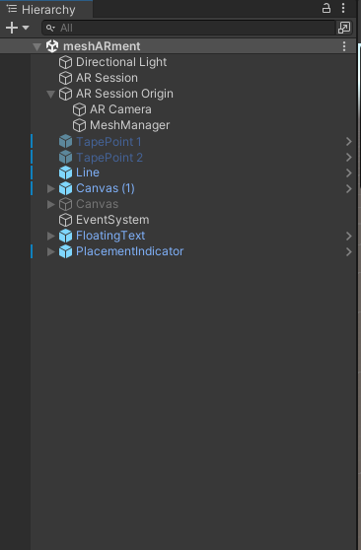
2. Technical Overview: Project Hierarchy
Notes:
One Scene with typical AR prerequisities
AR Session Origin contains mesh Manager for mesh rendering (detail follows)
Two inactive Game Objects (Tape Points) that are activated during runtime by user input
Line Renderer for visualization between points
Canvas for UI
GameObjects for Text (bottom Right) and Placement Indicator

Slide 5
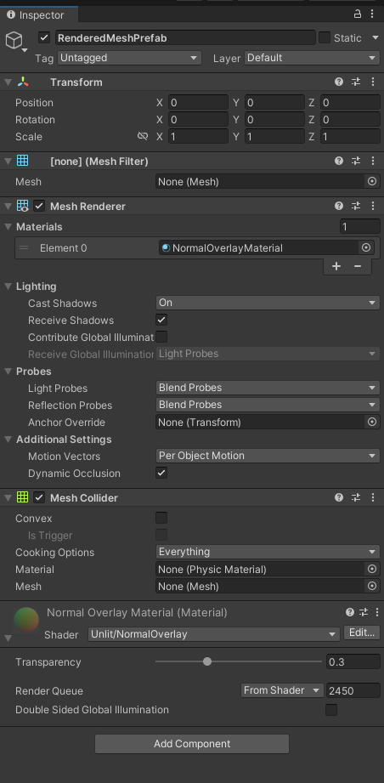
2. Technical overview: Meshing
Game object with ARMeshManager Script in AR Session Origin
Script uses Mesh Prefab
Mesh Prefab consists of Mesh Renderer mit NormalOverlayMaterial (Shader)
Mesh Collider for Physics

Slide 6
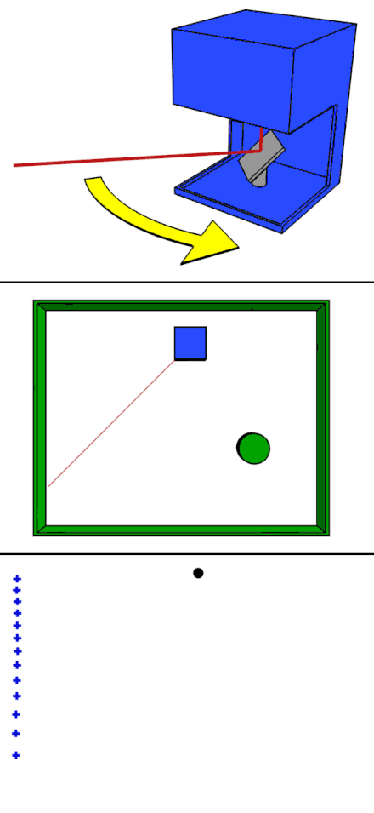
2. Technical Overview: LiDaR
Short for Light Detection and Ranging
Provide depth information in realtime
Combined with sensor data from gyroscope and optical system to gain 3D information
Laser beam gets deflected on scanner system
time of flight is measured and allows calculation of distance
https://de.wikipedia.org/wiki/Lidar#/media/Datei:LIDAR-scanned-SICK-LMS-animation.gif

Slide 7
2. Technical Overview: TapeManager
Raycasting the placement Indicator
On touch event: Place Indicators
Render Line between Indicators
Calculate desired measurement between indicators
Show Measurement
Allow user to choose between distance, inclination in degree or percent

Slide 8
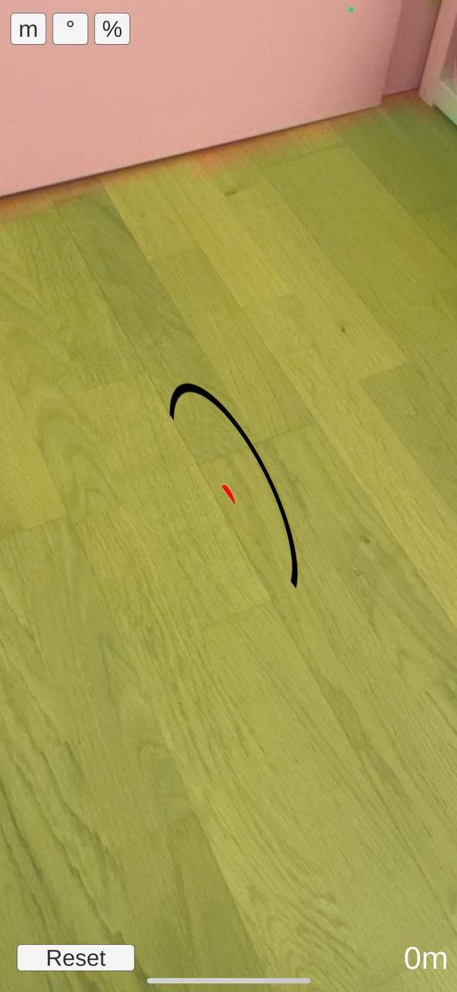
3. User experience
Plausible measurements
Intuitive to use
Optical hint for inclination given with shaded transparent overlay
Notes:
Discuss the design of your app and how it enhances the user experience.
Talk about any usability testing you conducted and the results you achieved.

Slide 9
4. Future work:
Placement Indicator in wrong rotation
Disappears behind vertical planes
Raycasting on visual markers, not on LiDaR generated mesh
Selection for Inclination Measurements not working yet
App Icon Missing
Additional Measurement displaying 0m
Notes:
Discuss any plans you have for improving or expanding the app in the future.
Talk about any potential challenges or limitations that may need to be addressed.

Slide 10
5. Conclusion
Prototype, but work still in progress
LiDaR a nice-to-have, but is it really a benefit?
Long loading times, data accuracy comparable to optical system
Notes:
Summarize the main points of your presentation and restate the value of your app.
Thank your audience for their attention and time.

Slide 11
Thank you for you attention
Notes:
Summarize the main points of your presentation and restate the value of your app.
Thank your audience for their attention and time.

Slide 12
Appendix: Prerequisities
Coding Scripts in Visual Studio
Build developer signed app for iOS
Virtual Reality with ARKit in Unity
Push Project to Git
Pull Project on Virtual MacOS
Open and Export XcodeProject

Slide 13
Appendix: Challenges
Installation of MacOS in a Virtual Environment on a Windows machine
Different incompatible Software versions in the Apple Ecosystem
Inperformant virtualisation

Slide 14
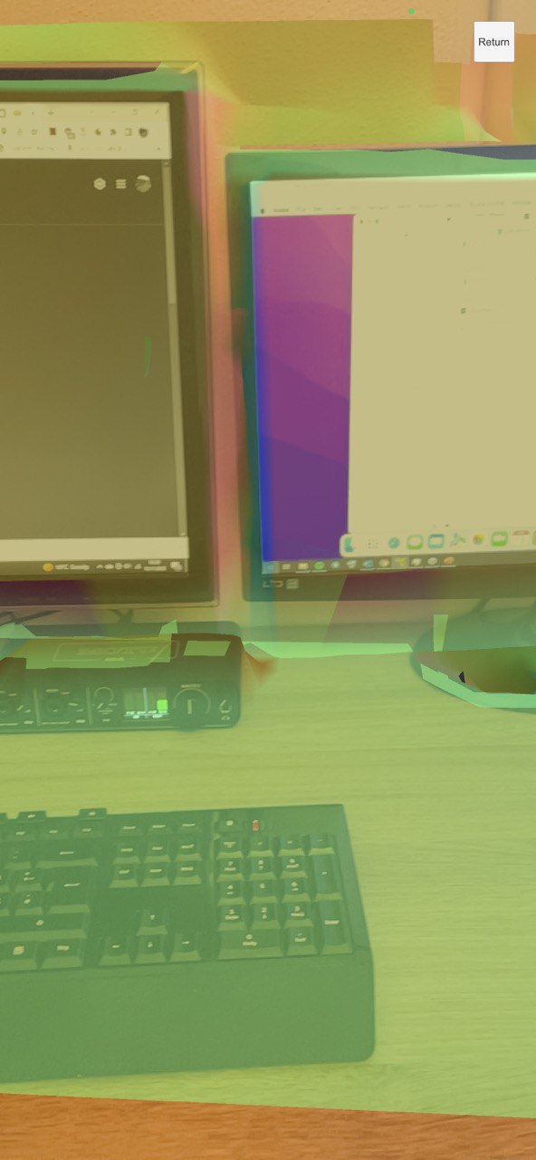
Appendix: Current Progress
Tested Workflow from Unity to App
Arfoundation Samples built and running on mobile device
LIDAR samples are working

Slide 15
Appendix: Outlook
Coding of colouring of vertices
Placement of a virtual spirit level at two points with display of incline
Expansions like a measure tape or virtual hammer ;)

